Slide 1
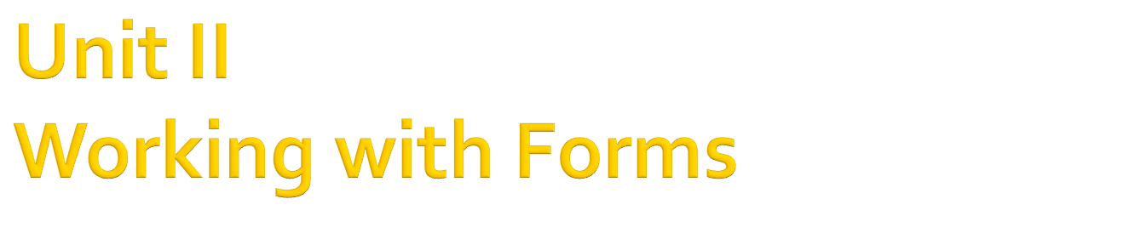

Slide 2

The form is a container for all the controls that make up the user interface.
Forms have built-in functionality that is always available without any programming effort on our part.
The forms that constitute the visible interface of our application are called Windows forms, which include both the regular forms and dialog boxes.

Slide 3
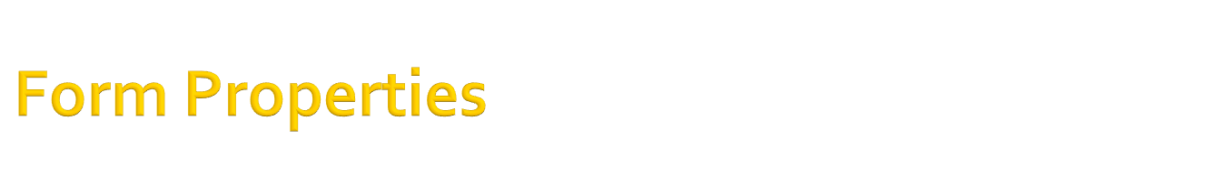
Property Name | Description | Sample Values
Name | Used for naming a form | frmFact
Text | Used for giving title to the form in the title bar.
Size (Width, Height) | Used for setting the form size | 300,300
MaximumSize (Width, Height) | Used for setting the maximum size the form will take | 500,500
MinimumSize (Width, Height) | Used for setting the minimum size the form will take | 100,100
WindowState | Used to set the window state | Normal(default)/ Minimized/Maximized
StartPostion | Used to set in which location of the screen will the form be displayed during run-time | Manual/CenterScreen/WindowsDefaultLocation/WindowsDefaultBounds/CenterParent

Slide 4
Property Name | Description | Sample Values
ControlBox | Used to make the minimize, maximized and close buttons appear/removed from the form | True(by default)/ False
MinimizeBox | Used to either display or remove the minimize box | True(default)/False
MaximizeBox | Used to either display or remove the maximize box | True(default)/False
ShowIcon | Used to either display or remove the icon on the form title | True(default)/False
IsMDIContainer | Used to set the form to be a container for other forms to run in | False(default)/True

Slide 5
Property Name | Description | Sample Values
BackColor | Used for changing the background color of the form a selected color | White, Gray, Blue, etc
BackgroundImage | Used for setting an image as the background of the form | None(default)
Font | Used for setting the font family/style and size, that will be used to display any text in the body of the form
FormBorderStyle | To change the border of the form None - no border and title bar Anything having fixed means form not resizable at run-time and sizable means vice-versa. Values Fixed3D: give a 3D effect FixedSingle & FixedDialog: border width is less Sizable FixedToolWindow No minimize/maximize button present SizableToolWindow

Slide 6

We can set the tab order of the controls.
Each VB.NET control has a TabIndex Property.
  This property will determine in-which order the controls will be reached by pressing on the tab key
  TabIndex value begins from 0 onwards
  By default, the TabIndex value is set in the order in which you add controls to your form.
    Thus, the first control added will have a TabIndex value of 1, then the second control will have an index of 2 and so on.
    Thus, forming a tab order.
Changing the tab-order:
  Either changing the TabIndex value of individual control, or
  Go to View Menu, click on Tab Order option

Slide 7

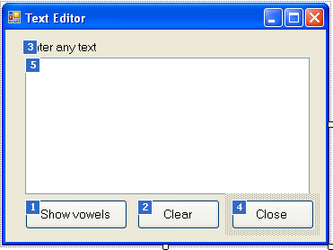
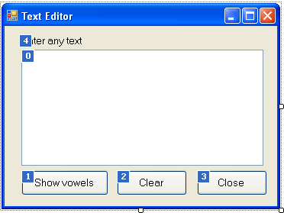
Press Esc To Remove The Tab Order
To set the Tab Order of the controls, click each control in the order in which you want them to receive the focus.

Slide 8

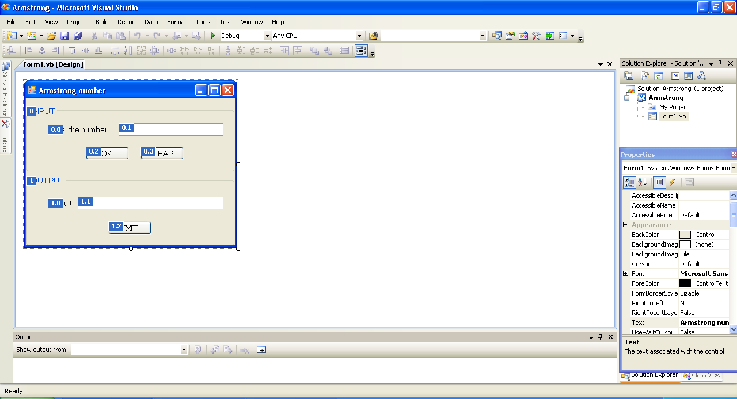

Slide 9

Each control also has the TabStop Property. Can be either True/False
This property is set to True, by default.
This property settings will determine whether the control will be focus whenever we press the Tab Key
  If true, then the control will act as a stopping point when the Tab Key is pressed
  If false, then the control will be bypassed when the Tab Key is pressed

Slide 10

After the controls are placed in their exact positions, it is better to lock the controls, so that we won’t move them around by mistake.
We can lock the controls in their places either
  by setting the individual control’s, Locked property to True, or
  by locking all the controls on the form with the Format > Lock Controls command. This acts as a Toggle command, thus, after locking we can unlock by again pressing on the same options

Slide 11

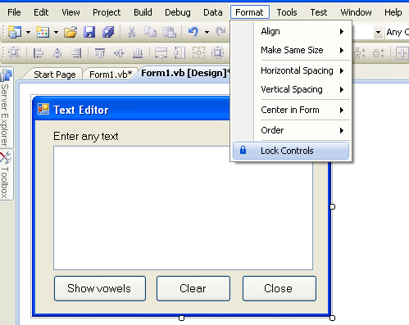
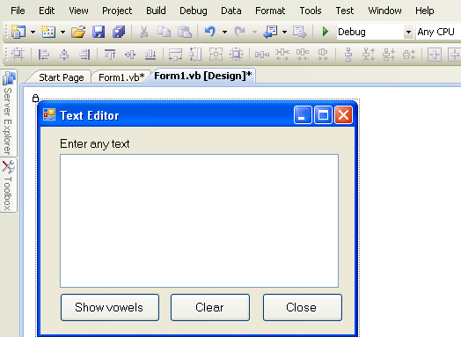

Slide 12
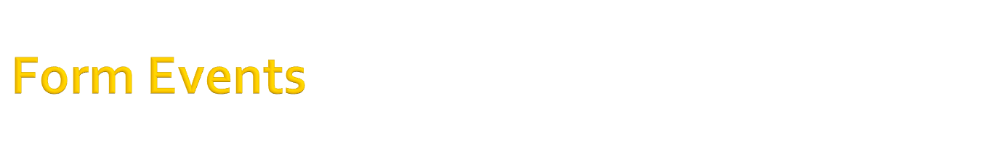
The Form object triggers several events, the most important of them being:
  Load – When the Windows Application when the application is loaded into memory for execution, this event takes place for the form.
  Activate – Each time a form is activated, the Activate event takes place.
  Deactivate – Likewise, when another form is activated, the previously active form receives the Deactivate event.
  Resize – This event is fired every time the user resizes the form with the mouse.
  Paint – This event takes place every time the form must be refreshed. For example, if the form has a background image and its layout is stretched, every time the form is resized, the image gets adjusted.
  FormClosing – This event is fired when the user closes the form by clicking its close button.

Slide 13
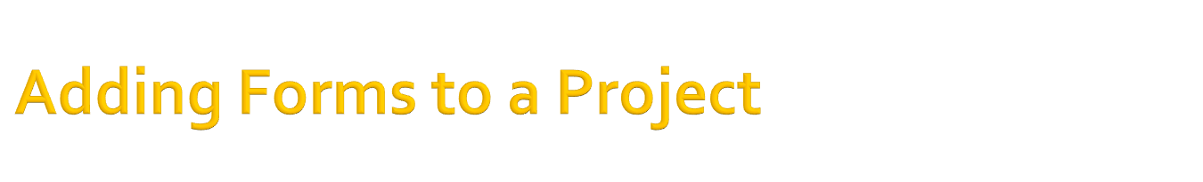
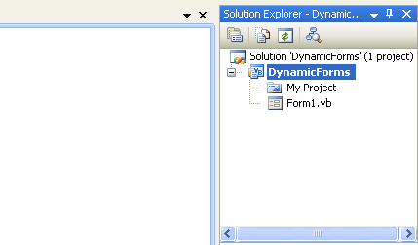
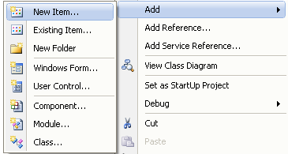
In the Solution Explorer, we can right-click on the Project Name
Then, choose Add > New Item
This will open up a dialog box, choose the item you want to add. Example: select Windows Form for a form
Then click on Add
Right click

Slide 14

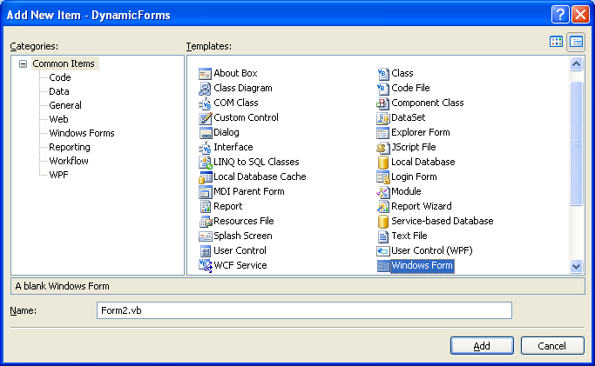
Select Item to be added
Click on Add

Slide 15

If an application requires two forms, the first form named as Form1 has a button which when clicked opens another form Form2, then the command to be used are:
Form2.Show()
Form2.ShowDialog()
Thus, forms can be opened in two modes
  Modeless: The Show() method opens form in this mode
  Modal: The ShowDialog() method opens form in this mode

Slide 16

Modeless manner:
  Forms displayed in this manner have equal stature on the desktop, and the user can switch between them.
Modal manner:
  While a modal form is open, it remains on top of the desktop and we can’t move the focus to any other form of the same application.
  A dialog box is simply a modal form.

Slide 17

Dialog Boxes are special types of forms with rather limited functionality
They are used to prompt the user for data/response
There are also some dialog boxes which are known as Common dialog boxes
Example: Open and Save dialog boxes are the two most commonly
used dialog boxes
One characteristic of dialog boxes is that they usually contain an Ok and a Cancel button.
However, like forms, dialog boxes may contain a few simple controls, such as Labels, TextBoxes, and Buttons.

Slide 18
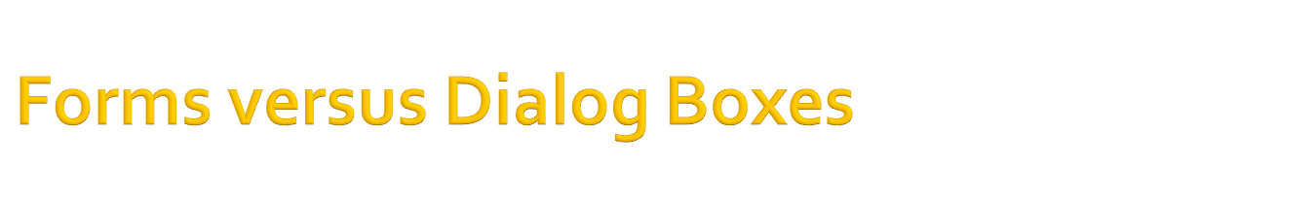
The difference between forms and dialog boxes is artificial.
Typically, a dialog box is a good old Form with its
  FormBorderStyle property set to FixedDialog and
  ControlBox, MinimizeBox and MaximizeBox Properties set to False.

Slide 19

We can also created forms at run-time.
In VB.NET Forms are objects of the Form Class.
  Thus , by creating an object of Form Class in our source code, we can create a blank form
  Syntax: Dim <form_name> As New Form()
  To display the created form, we can use either of the two methods
  <form_name>.Show() , or
  <form_name>.ShowDialog()
  On this form, we can add controls by dynamically creating the controls required and placing them on the form to have a

Slide 20

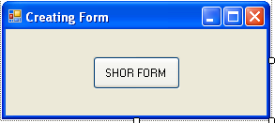
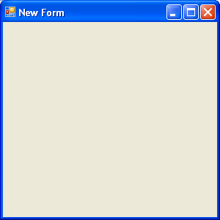
Public Class Form1
Private Sub btnShow_Click(ByVal sender As System.Object, ByVal e As
System.EventArgs) Handles btnShow.Click
Dim f2 As New Form()
f2.Text=“New Form”
f2.Show()
End Sub
End Class

Slide 21

A typical application has more than a single form. When an application starts, the main form is loaded.
We can control which form is initially loaded by setting the startup object in the Project Properties window.
  To get this go to Project Menu > ProjectName Properties Option, or
  To open this, right-click the project’s name in the solution explorer and select properties.
By default, Visual Studio uses the first form as the startup form.

Slide 22

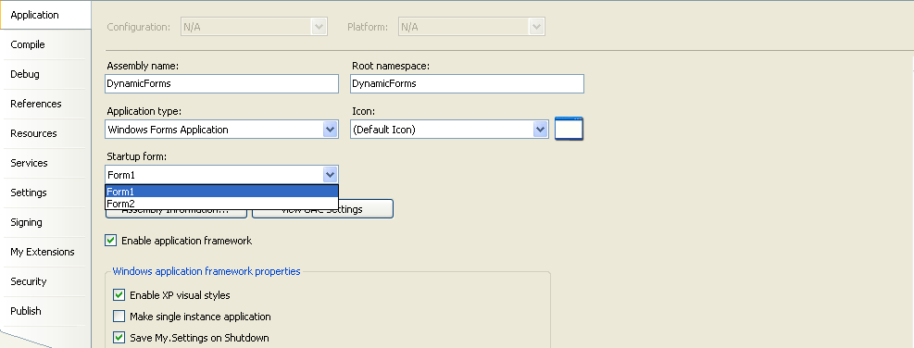
We can select the required form to be the Startup form

Slide 23

Sometimes, we need to control one form within another’s code.
Controlling the form means
  accessing its controls and
  setting or reading values from within another form’s code.
The simplest method for two forms of a project to communicate with each other is via public variables.

Slide 24

These variables are declared in the form’s declaration section, outside any procedure, with the keyword Public
Syntax:
Public <variable_name> As Datatype
Example: Public varNum As Integer
To access a public variable declared in Form1 from within another form’s code, we must prefix the variable’s name by the name of the form
Syntax:
<FormName>.<variable_name>
Example:
Public Class Form2
Form1.varNum=100
End Class
We can access public variables setting or getting their values

Slide 25

We can easily access any control belonging to a form from another form.
To do this, we simply prefix the name of the control with the name of the form it belongs
If the Form1 contains the TextBox1 control, we can read its text in Form2, by writing:
Public Class Form2
……..
Dim s as String
s=Form1.TextBox1.Text
……..
End Class
We can access the any control for setting or getting the values

Slide 26

If required, a form can also be hidden from the view of the user
The method used is Hide() method of the Form Class
Syntax:
<Form_name>.Hide()
Using this method, will not unload or stop execution of the application. This happens only when the form encounters the FormClosing Event
The application will still be in the run-time mode but the particular form will not be visible

Slide 27

It is possible to design dynamic forms which would allow to add or remove controls at run-time or creation of the user-interface dynamically
To understand how to create controls at run-time and place them on a form, we must know about the Controls collection.
All the controls on a form are members of the Controls property, which is a collection.
The Controls collection exposes several members for accessing and manipulating the controls at run-time, and these members are:
  Add method
  Remove method
  All method
  Count property
  Clear method

Slide 28
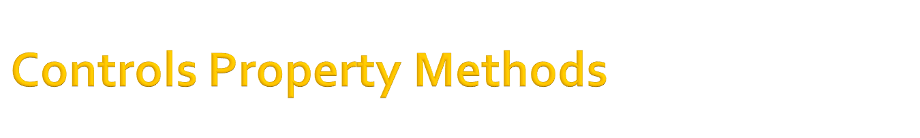
Add method – Adds a new element to the Controls collection.
Example: Me.Controls.Add(controlObj)
Remove method – Removes an element from the Controls collection.
Example: Me.Controls.Remove(controlObj)
Count property – Returns the number of elements in the Controls collection.
Example: Me.Controls.Count
All method – Returns all the controls on a form as an array.
Clear method – Removes all the elements of the Controls array

Slide 29

Public Class Form1
Dim btnOkAs New System.Windows.Forms.Button
Dim txtNew As New System.Windows.Forms.TextBox
Dim lblnew As New System.Windows.Forms.Label
Private Sub frmruntm_Load(ByVal sender As
System.Object, ByVal e As System.EventArgs)
Handles MyBase.Load
lblnew.Text = "Enter a number : "
lblnew.Left = 20
lblnew.Top = 20
Me.Controls.Add(lblnew)
txtNew.Text = ""
txtNew.Left = 120
txtNew.Top = 20
Me.Controls.Add(txtNew)
btnOk.Text = "Click"
btnOk.Left = 100
btnOk.Top = 60
btnOk.Width = 80
Me.Controls.Add(btnOk)
End Sub
End Class

Slide 30

The With Statement is enclosed within the With…End With tags
This statement can be used to enclose the property settings of the control. In this manner we will not be required to mention the control name everytime we access its properties.
Syntax
With controlObj
.property1 = <value>
.property2= <value>
……..
.propertyN = <value>
End With
Example
With btnOk
.Text = "Click”
.Left = 100
.Top = 60
.Width = 80
End With
Me.Controls.Add(btnOk)

Slide 31
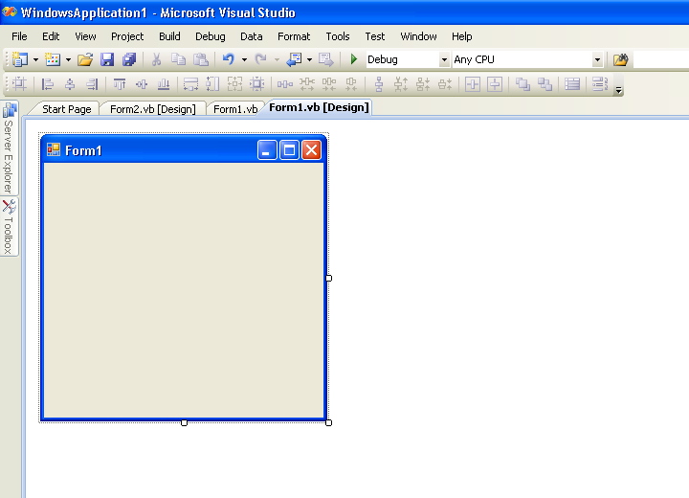

Slide 32
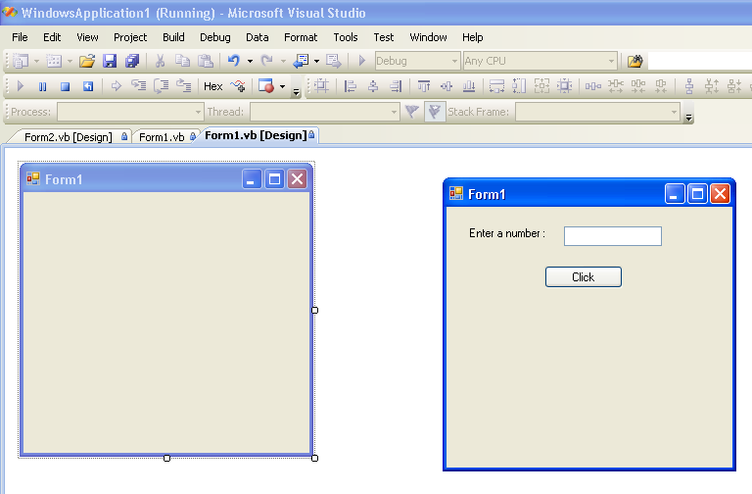

Slide 33
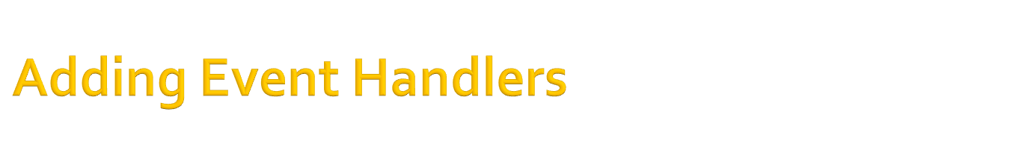
The AddHandler statement connects a control’s event to a specific event handler.
The syntax is:
AddHandler ctrlName.event, New System.EventHandler(Address of subName)
Example:
AddHandler btnOk.Click, New System.EventHandler(AddressOf BtnClick)
      Private Sub BtnClick(ByVal sender As Object, ByVal e As System.EventArgs)
      … ….
      … …
      End Sub

Slide 34

Two special properties associated each control that can be placed on the form.
They are
  Anchor and
  Dock Properties
These properties are concerned with how the controls will be placed on the form.
These properties allow us to specify how the controls will be arranged with respect to the edges of the form when the user resizes it.

Slide 35


Control
For any control on the form, its Anchor property will display a little square within a larger square, and four pegs that connect the small control to the sides of the larger box.
Pegs known as anchor
The large box is the form and the small one is the control.
The four pegs are the anchors, which can be either white or gray.
The gray anchors denote a fixed distance between the control and the form. This is known as Anchoring
In this case of the above figure, when the form is resized, the control retains its size and its distance from the top-left corner of the form.

Slide 36

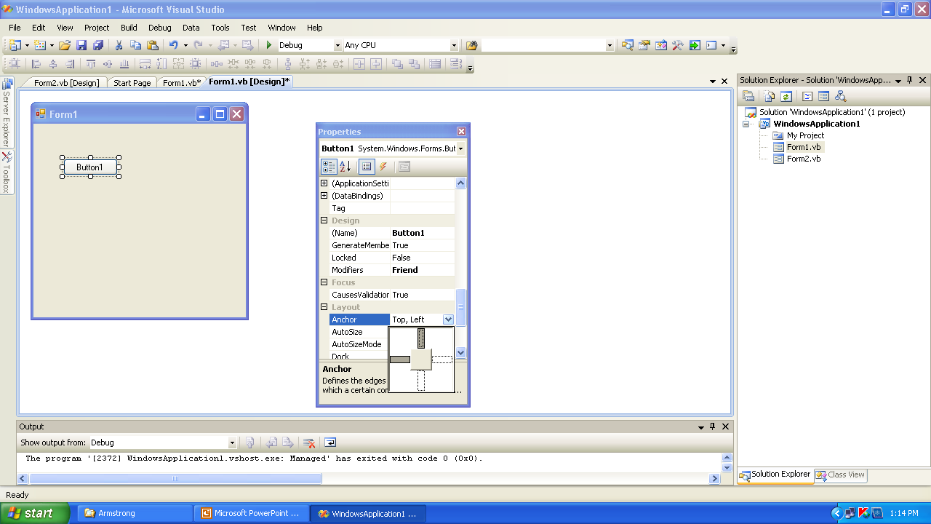

Slide 37

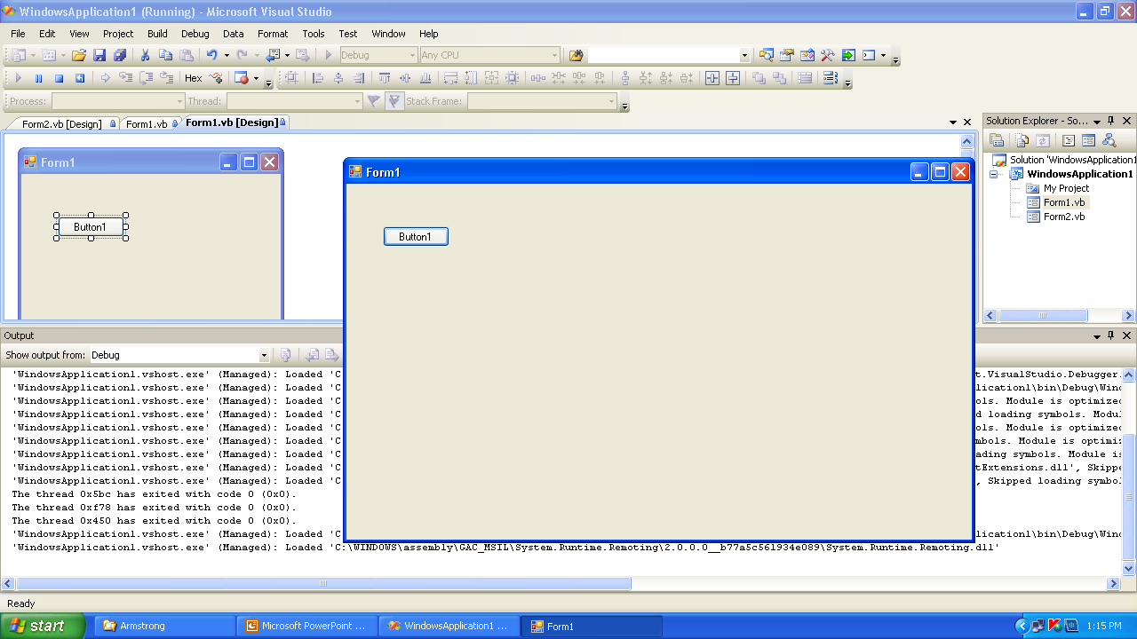
Due to the anchor property , the anchors set are Top-Left(Default)
Thus, the top-left corner for this control is fixed

Slide 38

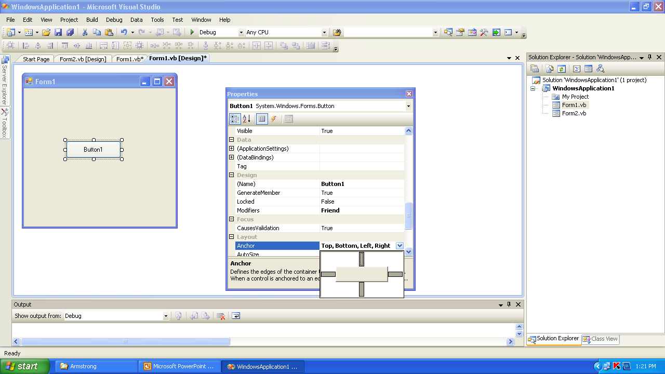

Slide 39

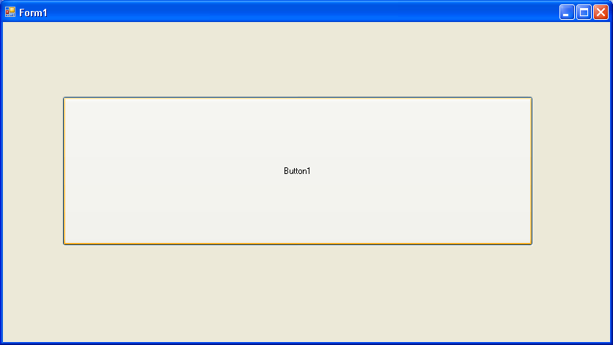
In the default Anchor property, all the corners are made fixed due to which the shape of the button increases as we resize the form

Slide 40

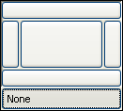
The Dock property, which determines how a control will dock/placed on the form.
The default value of this property is None.
The various rectangular shapes are the settings of the property.
If we click the middle rectangle, the control will be docked over the entire form.

Slide 41

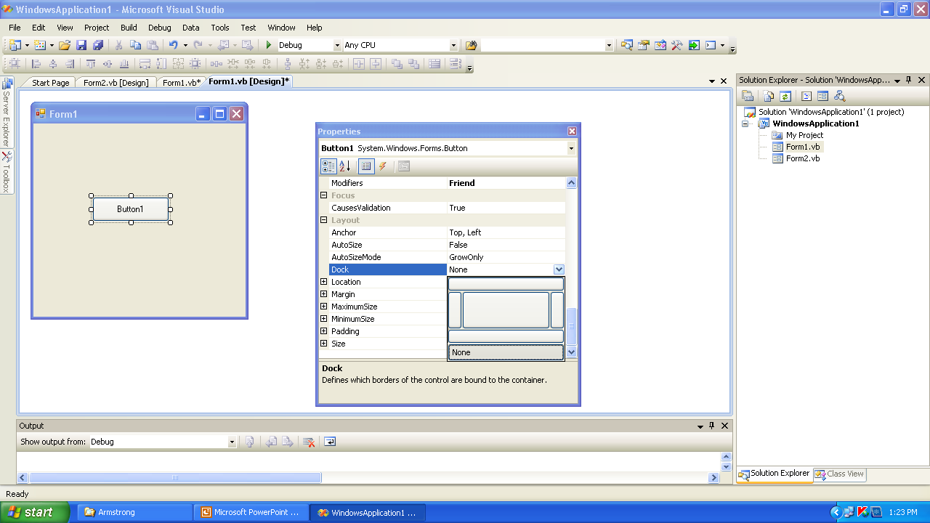

Slide 42

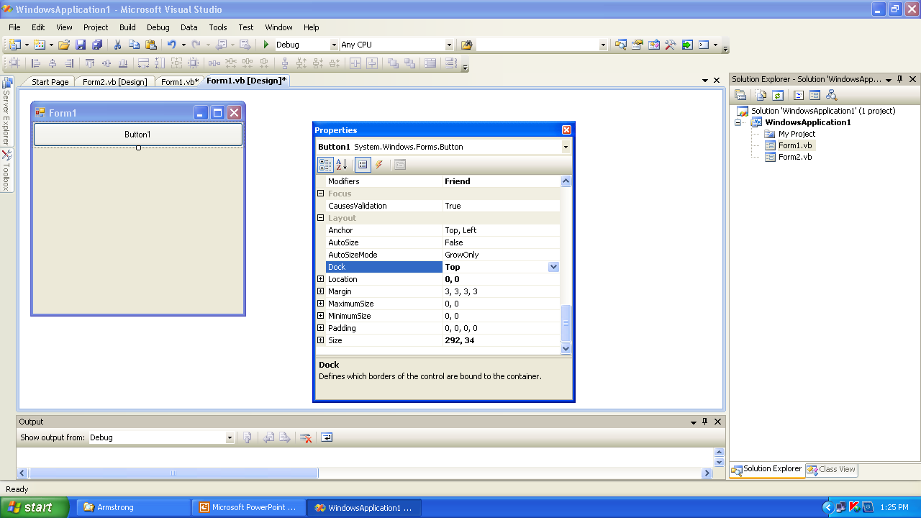

Slide 43

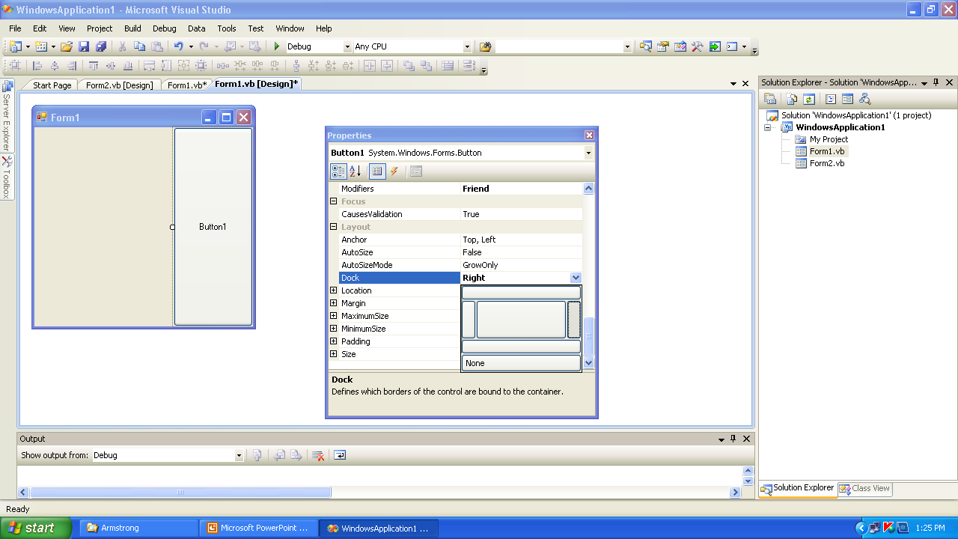

Slide 44

